Slide 1


PayFlow

Slide 2

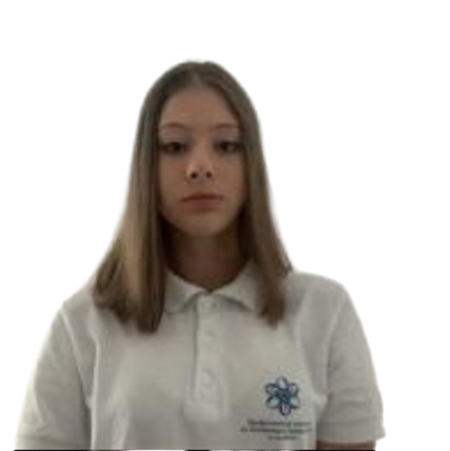
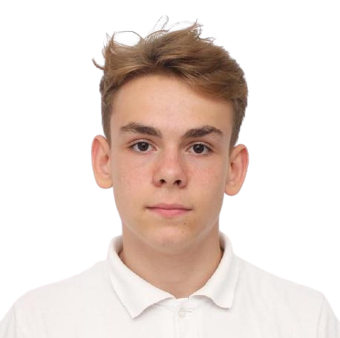
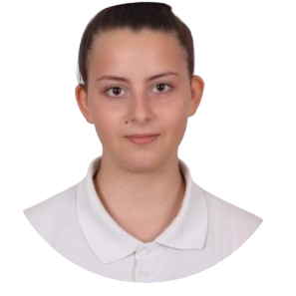
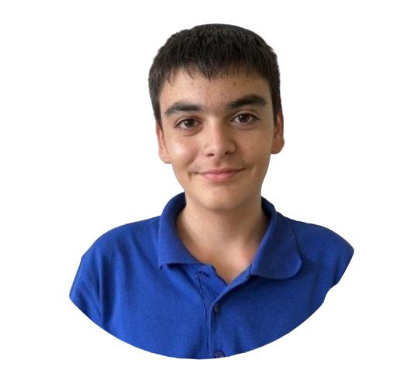
OUR TEAM
Yoana Georgieva Front-End Developer
Zarko Vladkov Front-End Developer
Polina Dineva Back-End Developer
Rostislav Nikolov Scrum Trainer

Slide 3

Our idea
In our bank it is easier to monitor the budget, expenses and income in a more efficient way!

Slide 4

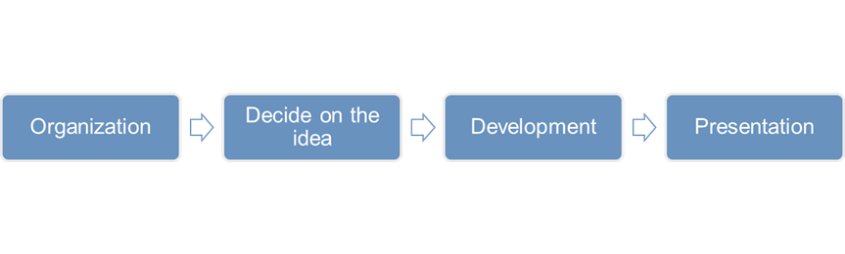
Stages of realization

Slide 5











TECHNOLOGY &
Innovation

Slide 6

Thank you for your attention

